Slide 1
BETA 25-26
Montford Middle school

Slide 2
Beta Fee Letter
Lets review the letter

Slide 3

agenda
25-26 Board members
Remind app
expectations
Volunteer hours
beta meetings
Lucky goat fundraiser
Math tutoring
Beta webpage

Slide 4

WE NEED YOU
25-26 Board members
President
Vice President
Secretary
Please email Mrs. Sullivan if you are interested in a position! We will appoint new board members prior to our next meeting!

Slide 5
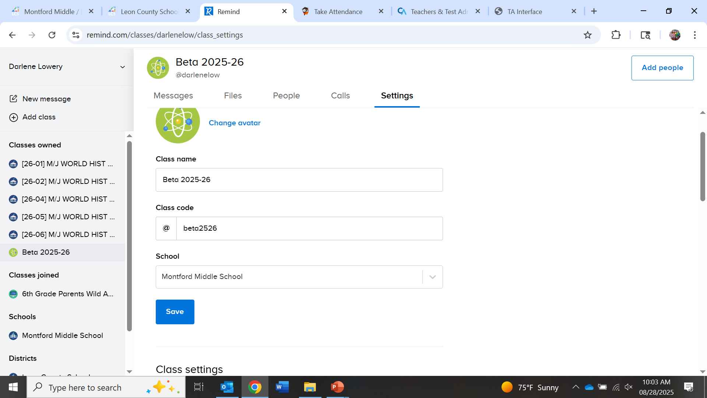
Join the remind!! This is How you will receive all of your information!
Open the Remind app on classlink
Click Add a Class
Join an Existing Class
Type in the information you see on the left
Wait for Approval to Join

Slide 6

Expectation of a
Beta member
AT least 10 volunteer hours – Yes DO MORE!!
Attend at least 6 meetings
Excellent citizenship
KEEP UP GRADES – ONLY 1 b ALLOWED
GET INVOLVED IN FUNDRAISERS/SERVICE PROJECTS

Slide 7


BETA WEBPAGE
USE IT TO LOOK AT MEETING SCHEDULE use it to view the meeting powerpoints

Slide 8

Math tutoring Wednesdays In Mrs. Lowery’s Room
Are you in 8th grade or taking algebra?
Is math your thing?
Are you able to work patiently with others?
Are you good at explaining things?
Then you can earn lots of volunteer hours!
Email loweryd@leonschools.net

Slide 9
Volunteer opportunities
Montford Green Team
Plenty of hours to be made
Contact Ms. Barrett if interested barrettc@leonschools.net
Tutoring begins on September 17th at 8:45
No need to prepare, just come!

Slide 10


Lucky Goat Fundraiser
All proceeds go to relay for life
Start selling coffee: October 8
Orders Due:
October 22
Pick up your coffee:
November

Slide 11
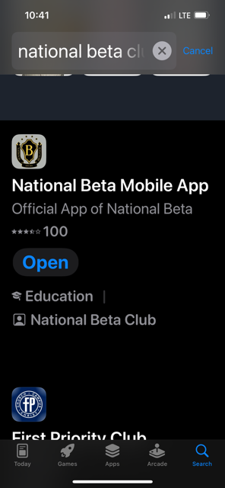
How do I log my service hours?
We will no longer be taking the paper service logs!
You can do this ALL on an app
If you don’t have a phone, please ask your parents to assist you by downloading the app
If you have your phone with you today, you can do this now!
The app is called National Beta Club- it looks like this:

Slide 12

Thank you
It’s going to be a great year of service to others!

